Slide 1
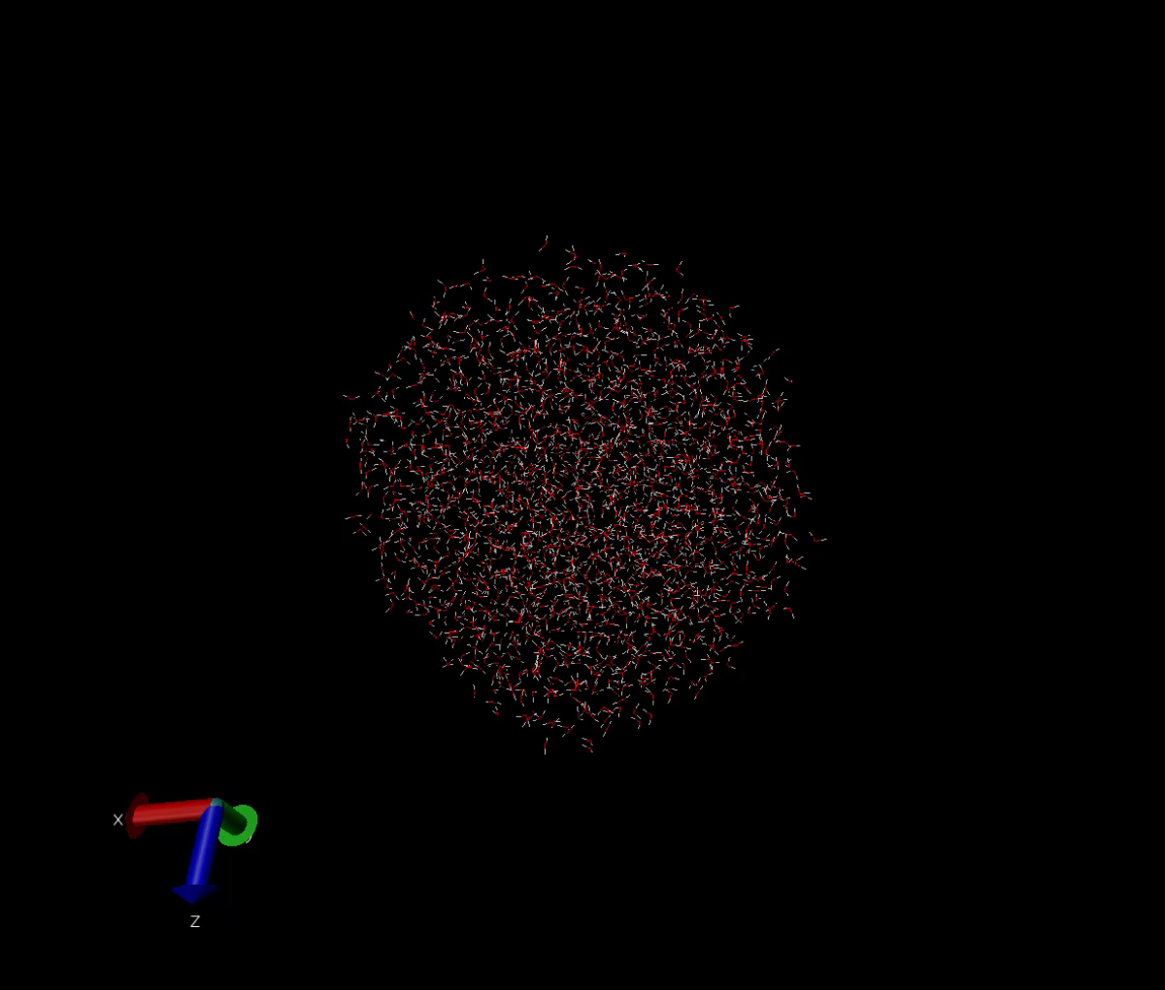
Simulating water analyzing Density
Asela Chandrasinghe
Notes:
Hi everyone my name is asela and I am not a physics major. I am a chemistry major, and while I do find pendulums and springs to be interesting I decided to pick a topic more chemistry related. So today I will be presenting to you guys about the research I did on simulating water and analyzing density as a function of radis

Slide 2
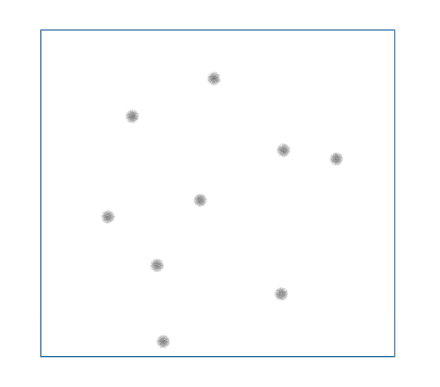
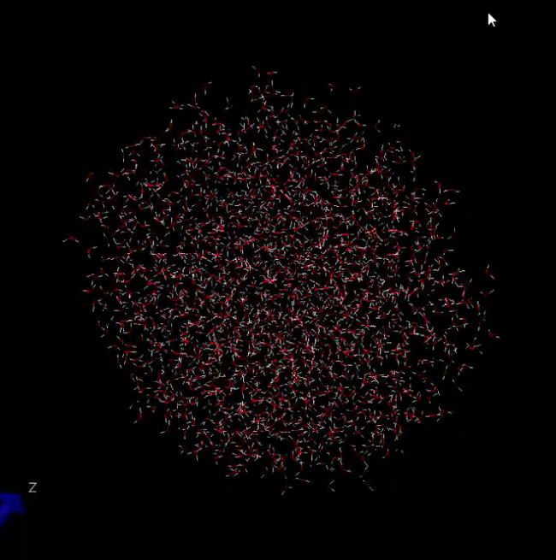
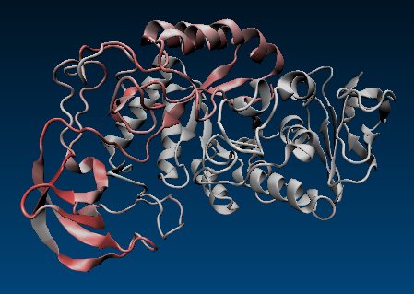
MOLECULAR DYNAMICS
Notes:
Molecular dynamics (MD) simulations is a method that uses equations of motion to directly simulate the dynamics of each particle within a system. Up here we have a couple of examples of systems that MD can simulate each increasing in complexity. So as the system gets more complex, so do the equations of motion for the particles within.
It can be used to simulate something as simple as a couple of particles in a 2D box, to molecules in 3D or even protiens.

Slide 3
How are the positions at each time step calculated?
Langevin integrator
Like the Verlet method
Newtons equations of motion replaced with Langevin equations of motion

Slide 4
Model parameters
Forces (Ameoba)
Integration method
Intermolecular
van der waal
dipole-dipole
charge- charge
quadrupole
Intramolecular
bond stretching
bond bending
Langevin integrator

Slide 5
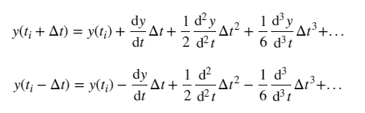
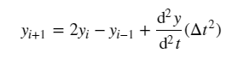
Verlet Method
Taylor expansion forward direction
Taylor expansion backward direction
Forward + backward

Slide 6
Motivation
Why study Molecular Dynamics?
Why study water?
Notes:
Motivation for this study lies behind the method and the subject.
In the field of chemistry MD is a perfect method because chemistry is all about studying the behaviors of particles which in our case is molecules. This summer I’ll be doing research with johnson as well and this was a perfect opportunity for me to familiarize myself with the method I’ll be using to study proteins this summer.
And why study water? Well fist of all water is pretty freaken cool. 71% of earths surface, 60 percent of human body, there is no doubt it plays a huge role in nature it deserves all of the attention. But more practically, I could have looked at something really simple as the 2D box with particles in it, but I wanted observe something with more realistitic. Water is simple enough to be able to simulate with the tools I had in johnsons lab, but with a lot of meaning because there are a lot of unique properties of water that I wanted to see if I could see them through molecular dynamics simulations.

Slide 7
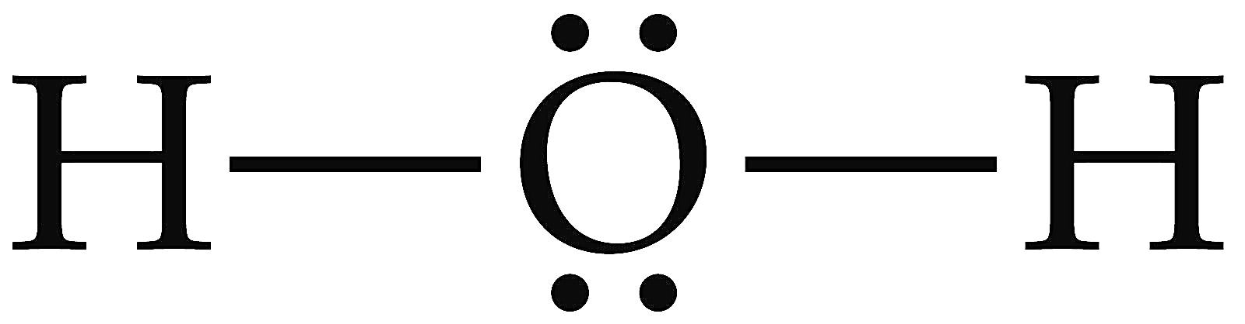
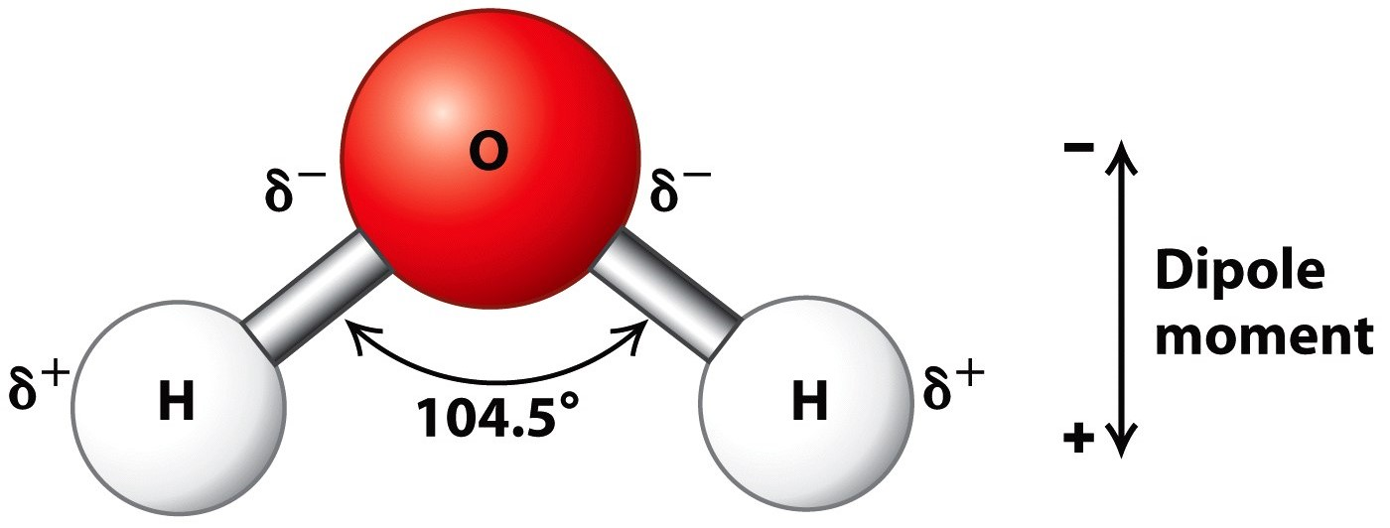
Water Structure
2 lone pairs
Bent geometry
Covalent bonds
Partial charges
Hydrogen bonding
https://alevelbiology.co.uk/notes/water-structure-properties/
http://wt.kimiq.com/lewis-dot-diagram-for-water/
Notes:
So these unqie properties of water lie behind its structure.

Slide 8
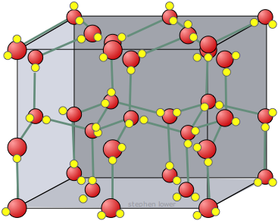
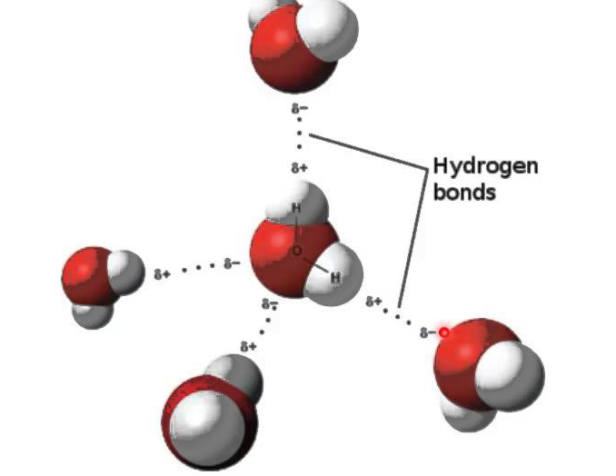
Water PRoperties
https://socratic.org/questions/how-is-hydrogen-bonding-among-water-molecules
https://chem.libretexts.org/Textbook_Maps/General_Chemistry_Textbook_Maps
Notes:
Water and density,
Hydorgen bonds are the strongest intermolecular forses. In Ice the water molecues assume a crystal structure dictated by a vast network of hydrogen bonds

Slide 9
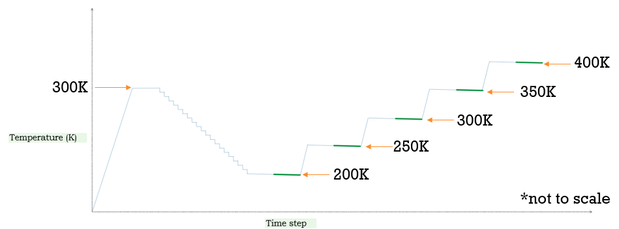
Simulation Setup
2,000 molecules
Annealing in 105,000 time steps
10,000 steps at 300K
5,000 steps at each temp going down
Equilibrate 6,000
Collect every 50 steps for 8,000 steps (160 samples)

Slide 10
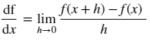
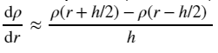
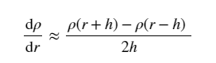
Numerical Method numerical derivative
Derivative Definition
Central Difference
Numerical Derivative Applied

Slide 11
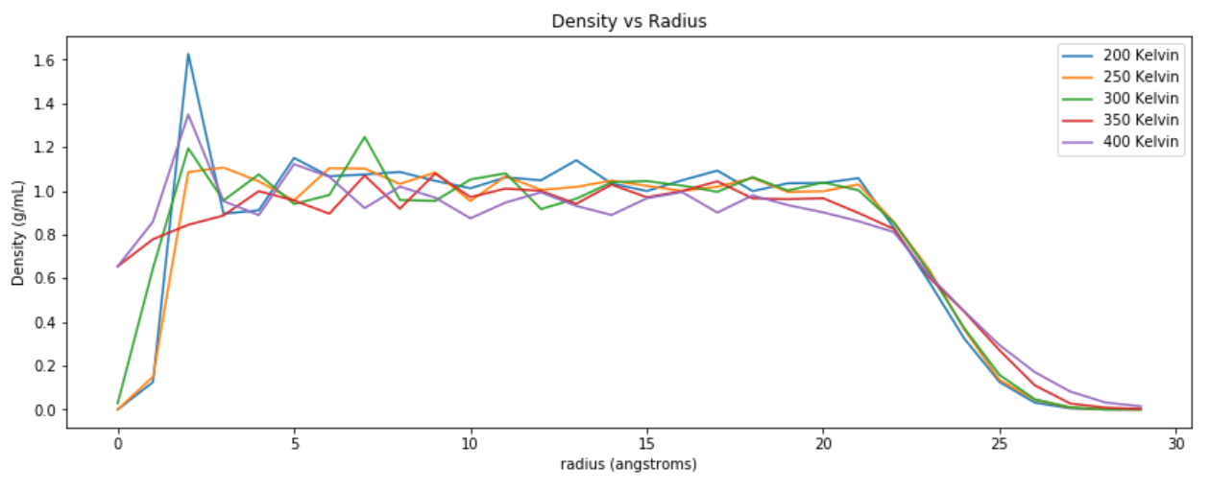
Results

Slide 12
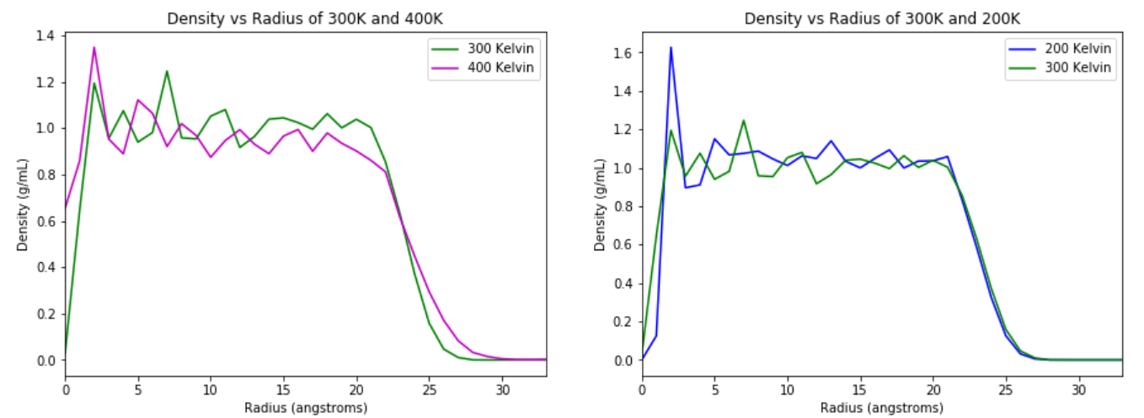

Slide 13
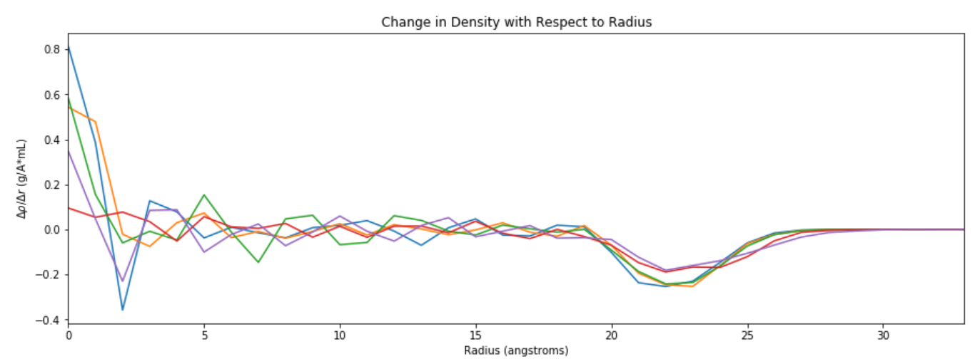

Slide 14
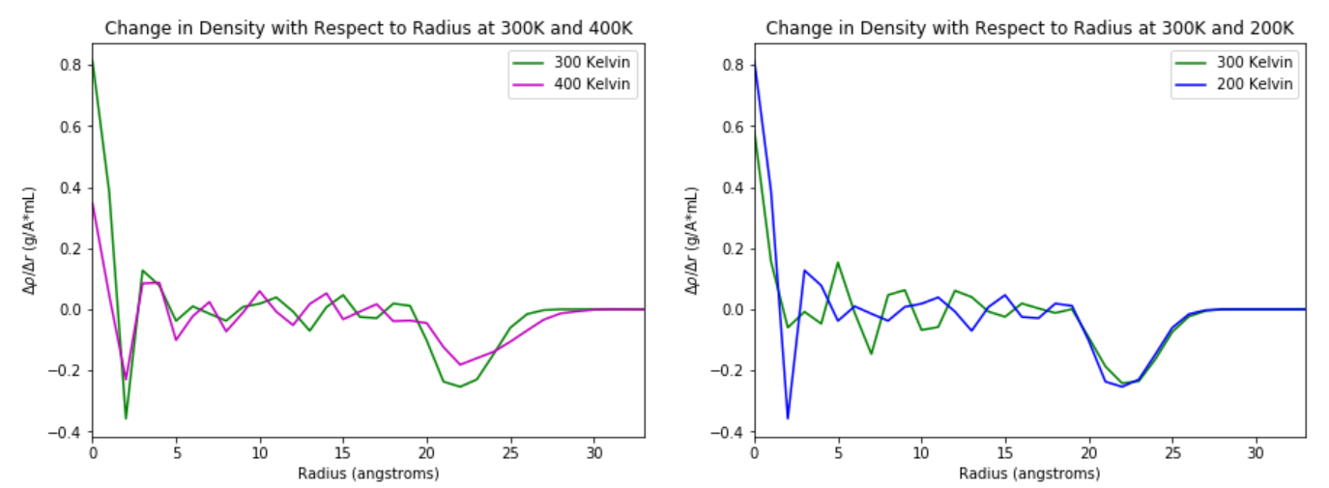

Slide 15
Future work
Notes:
I poured a lot of work into this project and I’ve worked hard on it for the last month. IT has become my baby of sorts but there are lots of opporturnity for growth.

Slide 16
Work Cited
Atkins, P. Physical Chemistry: Thermodynamics, structure, and change; Macmillan Higher Education: 2014; .
Ponder, J. W.; Wu, C.; Ren, P.; Pande, V. S.; Chodera, J. D.; Schnieders, M. J.; Haque, I.; Mobley, D. L.; Lambrecht, D. S.; DiStasio Jr, R. A. Current status of the AMOEBA polarizable force field. The journal of physical chemistry B 2010, 114, 2549-2564.
Schiller, U. D. An overview of integration schemes for molecular dynamics simulations. Lecture note 2008.
Giordano, N. J. Computational physics; Pearson Education India: 2006; .
Eastman, P.; Swails, J.; Chodera, J. D.; McGibbon, R. T.; Zhao, Y.; Beauchamp, K. A.; Wang, L.; Simmonett, A. C.; Harrigan, M. P.; Stern, C. D. OpenMM 7: rapid development of high performance algorithms for molecular dynamics. PLoS computational biology 2017, 13, e1005659.
Perlman, H.; USGS. The water in you https://water.usgs.gov/edu/propertyyou.html (accessed May 12, 2018).
Martinez, L.; Andrade, R.; Birgin, E. G.; Martinez, J. M. PACKMOL: a package for building initial configurations for molecular dynamics simulations. Journal of computational chemistry 2009, 30, 2157-2164.

Slide 17
Awknowledgements
Dr. Kevin Johnson
Dr. Danielle McDermott

